Slide 1
Relational Database Operations
Can be categorized into two groups:
1. Updates
  Insert
  Modify
  Delete
  All update operations must satisfy all
  constraints (entity integrity, referential integrity
  and enterprise constraints)

Slide 2
Relational Database Operations
2. Retrievals
  Relational Algebra operations are used to specify retrievals

Slide 3
Relational Algebra Operations
  SELECT operation
  PROJECT operation
  Set theoretic operations
    UNION, DIFFERENCE, INTERSECTION and CARTESION PRODUCT
  JOIN Operation
    EQUI JOIN, NATURAL JOIN, INNER JOIN, OUTER JOIN, SELF JOIN

Slide 4
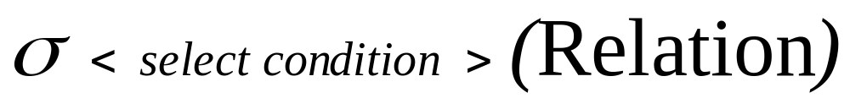
SELECT Operation
Used to select a subset of tuples from a relation that satisfy a selection condition
In other words, SELECT operation can be considered as a filter that keeps only those tuples which satisfy a qualifying condition
Here sigma denote select operator
Select condition is the Boolean expression specified on the attributes
Relation is either itself a relation or another select/project operation which results a relation

Slide 5
SELECT Operation
The resulting relation has the same attributes as the original relation.

Slide 6
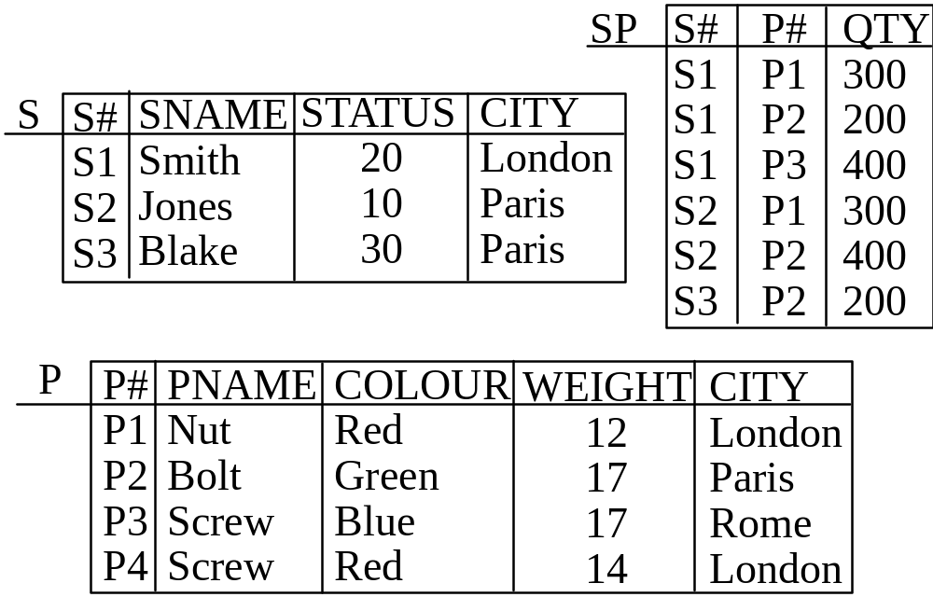
Example Database

Slide 7
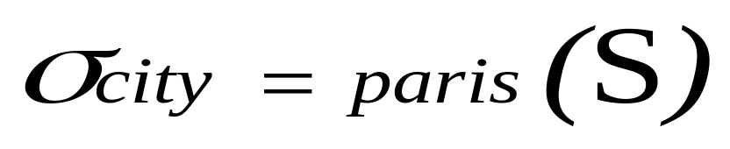
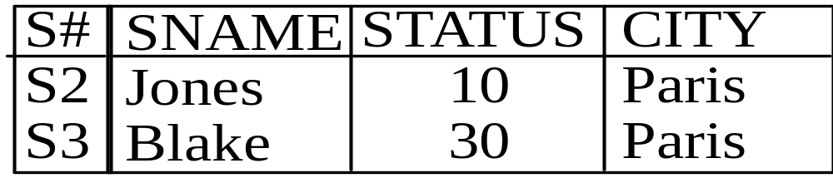

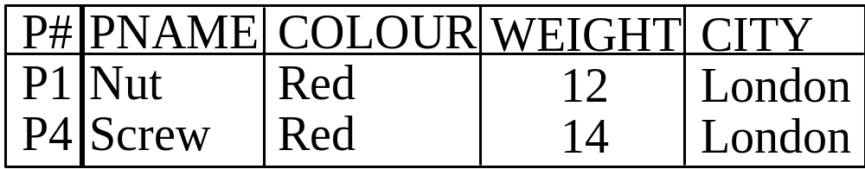
SELECT Operation

Slide 8
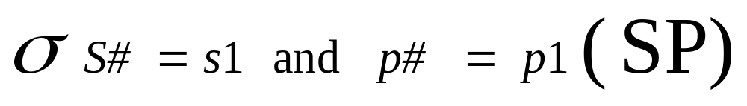
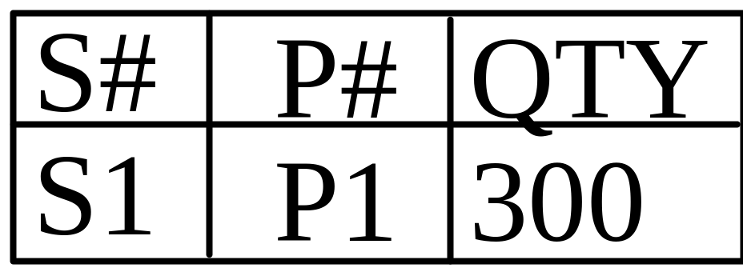
SELECT Operation(4)

Slide 9
PROJECT Operation
PROJECT operations selects certain columns from a relation and discards other columns and hence constructs a vertical subset of a relation
When we are interested in only certain attributes of a relation, we use PROJECT operation

Slide 10
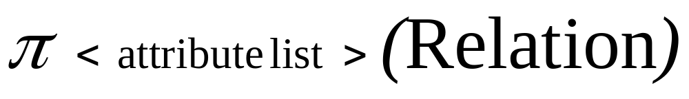
PROJECT Operation
Here pi denote project operator
Attribute list is list of attributes to be projected
Relation is either itself a relation or another select/project operation which results a relation

Slide 11
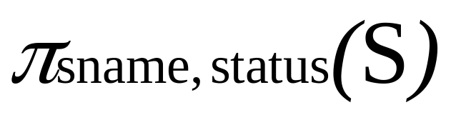
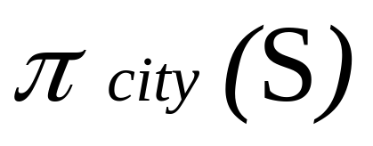
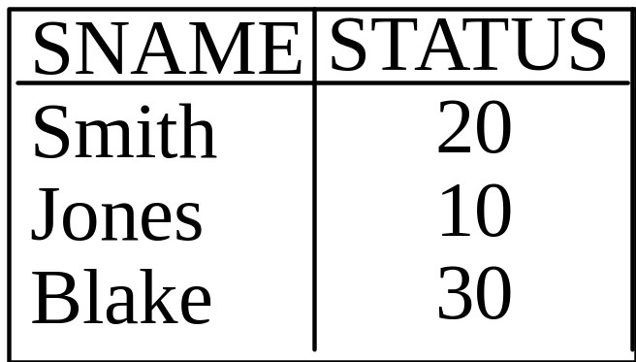

PROJECT Operation

Slide 12
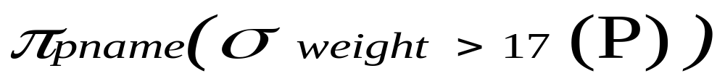
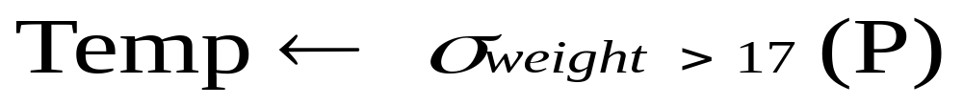
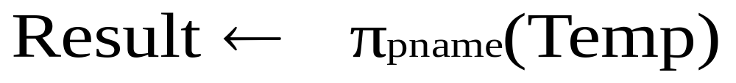
Sequences of operations
Many operations can be performed in sequence in one expression. For example, you want part names where part weight is less than 17.
Both operations can be written seperately

Slide 13
Set Theoretic Operations
UNION, DIFFERENCE, INTERSECTION binary operations - they take two relations
The two relations must be union-compatible i.e. same degree and matching domains (i^{th} column of first relation and i^{th} column of second relation have same domain)

Slide 14
UNION Operation
Denoted by RUS
Results in a relation that includes all tuples that are either in R or S or in both R and S
It is commutative i.e. RUS=SUR

Slide 15
INTERSECTION Operation
Denoted by R∩S
Results in a relation that includes all tuples that are both in R and S
It is commutative i.e. R∩S =S∩R

Slide 16
DIFFERENCE Operation
Denoted by R-S
R-S is a relation that includes all tuples that are in R but not in S
It is not commutative

Slide 17
CARTESIAN PRODUCT
Cartesian product of R and S is denoted by RxS
Also known as Cross Product or Cross join
In R x S each row of S is paired with each row of R
If there are m rows in R and n Rows in S then there will be m*n rows in RxS
If there are a attributes in R and b attributes in S then there are a+b attributes in RxS

Slide 18
CARTESIAN PRODUCT
What will be the result of Cartesian product of S and SP table?

Slide 19
JOIN Operation
JOIN operation used to combine related tuples from two relations into a single tuple
Very important operation: allows to process relationships among relations

Slide 20
JOIN Operation Example
Consider employee and department relations of an organization
Employee
Department
EID | ENAME
1000 | Naveed
1001 | Anees
1002 | Khurram
1003 | Asim
1004 | Mohsin
DID | DNAME | MGRID
101 | Accounts | 1000
102 | Development | 1001
103 | Research | 1001
104 | Management | 1000
105 | Academics | 1004

Slide 21
JOIN Operation Example
Now suppose we want to retrieve the name of manager of each department
We need to combine each department tuple with the employee tuple whose EID matches with the MGRID in department tuple

Slide 22
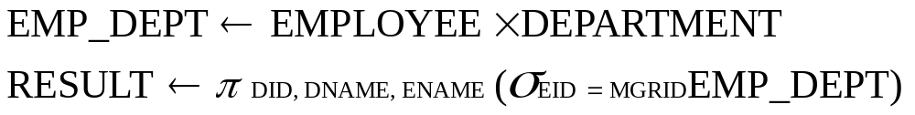
JOIN Operation Example
We can do it in two ways
We can simply use Cartesian product first and then project required attributes

Slide 23
JOIN Operation Example
We can use JOIN operation

Slide 24
JOIN Operation Example
Result of both methods will be:
Result
DID | DNAME | MGRNAME
101 | Accounts | Naveed
102 | Development | Anees
103 | Research | Anees
104 | Management | Naveed
105 | Academics | Mohsin

Slide 25
JOIN and Cartesian Product
Each tuple of result of JOIN is combination of one tuple from both relations
Then what is difference between JOIN and Cartesian Product?
Cartesian product is combination of each row of first relation with each row of second relation
In join only those combinations are included which satisfy the join condition

Slide 26
JOIN Condition and Theta Join
General join conditions is of the form:
  <condition> and <condition> …..<condition>
  Where each condition is of the form Ai Ө Aj
  Ai and Aj are attributes of first and second relation respectively
  Ai and Aj have same domain
  And Ө may be any comparison operator (<,>,=,<=,>=,<>)

Slide 27
EQUI JOIN
Most common join involves join condition with equality comparisons only
Such join is called EQUI JOIN

Slide 28
Join Cont….

